Slide 1
Mehran S. Fallah July 2020
Discrete Mathematics
Session XVI
Recurrence Relations

Slide 2
Introduction
In the previous session, we gave a systematic approach to solving linear homogeneous recurrence relations (LHRRs) with constant coefficients.
We considered the case where the characteristic roots were distinct as well as the case of multiple characteristic roots.
In this session, we introduce a method of solving linear nonhomogeneous recurrence relations (LNRRs) with constant coefficients.
It is called the method of undetermined coefficients and relies on finding a particular solution to the given LNRR.
The use of generating functions in solving a recurrence relation, or a system of relations, is another topic of this session.
We also employ the technique of generating functions to solve a special kind of nonlinear recurrence relation.

Slide 3
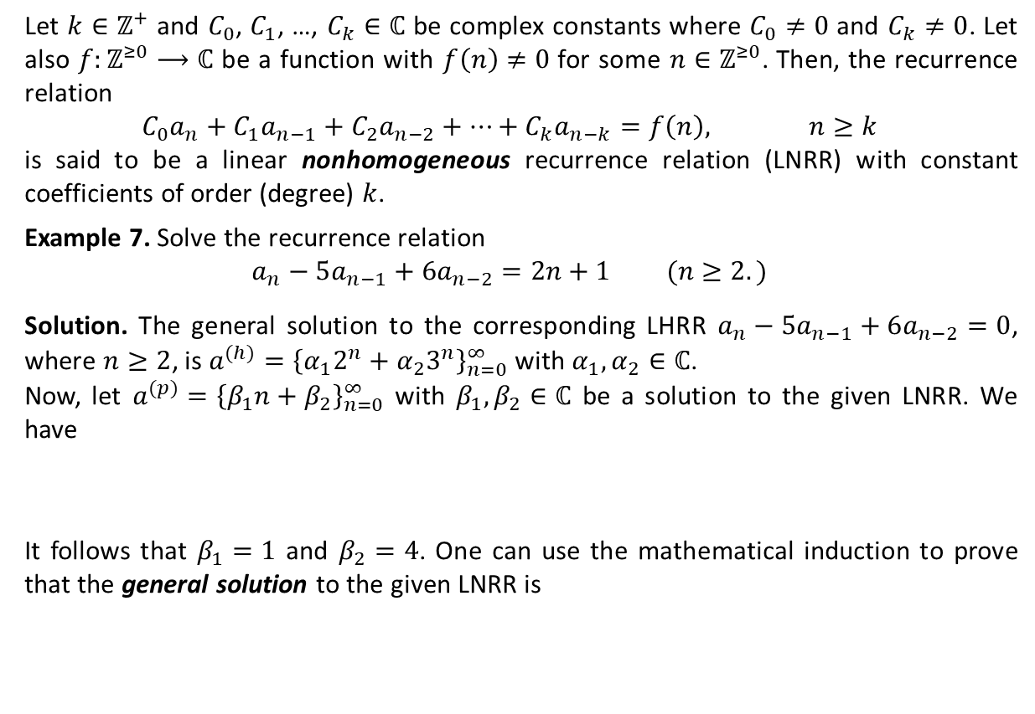
Linear Nonhomogeneous Recurrence Relations (LNRRs) with Constant Coefficients
Let $k∈ℤ^{+}$ and $C_{0}$, $C_{1}$, …, $C_{k}∈ℂ$ be complex constants where $C_{0}≠0$ and $C_{k}≠0$. Let also $f:ℤ^{≥0}⟶ℂ$ be a function with $f\left(n\right)≠0$ for some $n∈ℤ^{≥0}$. Then, the recurrence relation
$${C_{0}a}_{n}+C_{1}a_{n−1}+C_{2}a_{n−2}+⋯+C_{k}a_{n−k}=f\left(n\right), n≥k$$
is said to be a linear nonhomogeneous recurrence relation (LNRR) with constant coefficients of order (degree) $k$.
Example 7. Solve the recurrence relation
$$a_{n}−5a_{n−1}+6a_{n−2}=2n+1 (n≥2.)$$
Solution. The general solution to the corresponding LHRR $a_{n}−5a_{n−1}+6a_{n−2}=0$, where $n≥2$, is $a^{(h)}={\left\{α_{1}2^{n}+α_{2}3^{n}\right\}}_{n=0}^{∞}$ with $α_{1},α_{2}∈ℂ$.
Now, let $a^{(p)}={\left\{β_{1}n+β_{2}\right\}}_{n=0}^{∞}$ with $β_{1},β_{2}∈ℂ$ be a solution to the given LNRR. We have
It follows that $β_{1}=1$ and $β_{2}=4$. One can use the mathematical induction to prove that the general solution to the given LNRR is
$$a_{n}^{\left(p\right)}−5a_{n−1}^{\left(p\right)}+6a_{n−2}^{\left(p\right)}=\left(β_{1}n+β_{2}\right)−5\left(β_{1}n−β_{1}+β_{2}\right)+6(β_{1}n−2β_{1}+β_{2})$$
$$=2β_{1}n+\left(−7β_{1}+2β_{2}\right)=2n+1 (n≥2.)$$
$$a^{(h)}+ a^{(p)} ={\left\{α_{1}2^{n}+α_{2}3^{n}+ n+4 \right\}}_{n=0}^{∞}.$$
a particular solution: a solution not containing any arbitrary constants

Slide 4
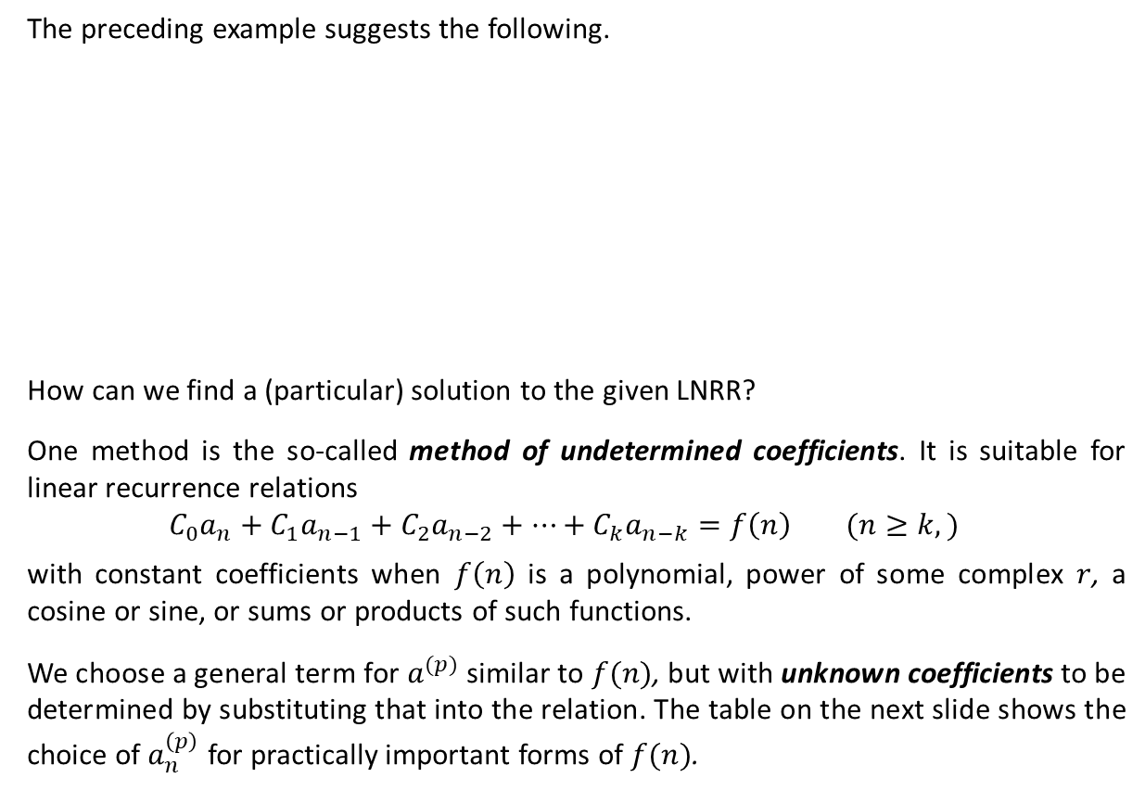
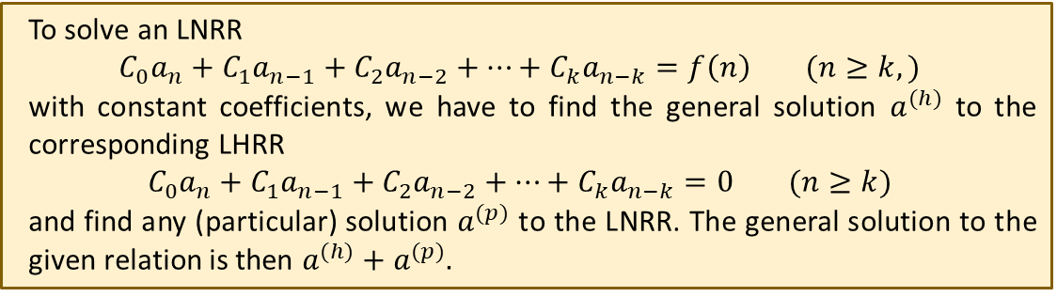
Solving LNRRs with Constant Coefficients
The preceding example suggests the following.
How can we find a (particular) solution to the given LNRR?
One method is the so-called method of undetermined coefficients. It is suitable for linear recurrence relations
$${C_{0}a}_{n}+C_{1}a_{n−1}+C_{2}a_{n−2}+⋯+C_{k}a_{n−k}=f\left(n\right) (n≥k,)$$
with constant coefficients when $f\left(n\right)$ is a polynomial, power of some complex $r$, a cosine or sine, or sums or products of such functions.
We choose a general term for $a^{(p)}$ similar to $f(n)$, but with unknown coefficients to be determined by substituting that into the relation. The table on the next slide shows the choice of $a_{n}^{\left(p\right)}$ for practically important forms of $f(n)$.
To solve an LNRR
$${C_{0}a}_{n}+C_{1}a_{n−1}+C_{2}a_{n−2}+⋯+C_{k}a_{n−k}=f\left(n\right) (n≥k,)$$
with constant coefficients, we have to find the general solution $a^{(h)}$ to the corresponding LHRR
$${C_{0}a}_{n}+C_{1}a_{n−1}+C_{2}a_{n−2}+⋯+C_{k}a_{n−k}=0 (n≥k)$$
and find any (particular) solution $a^{(p)}$ to the LNRR. The general solution to the given relation is then $a^{(h)}+a^{(p)}.$

Slide 5








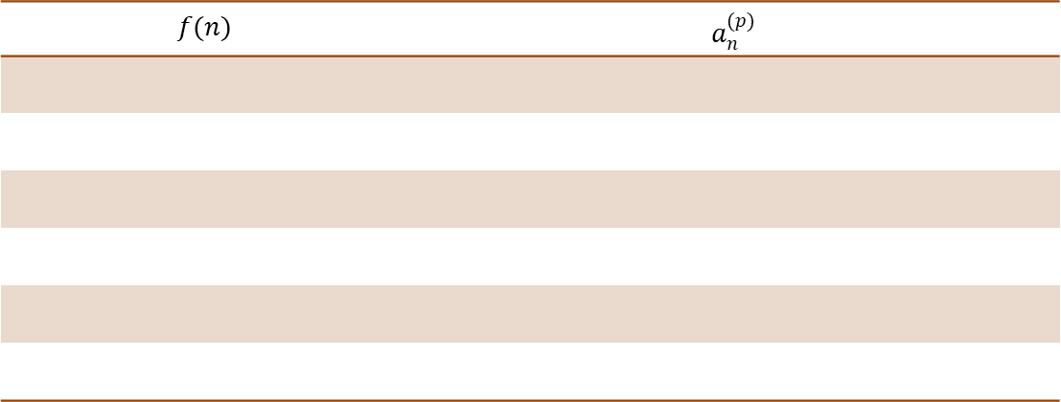



Solving LNRRs with Constant Coefficients (Ctd.)
Example 8. Solve the recurrence relation $a_{n}−2a_{n−1}+a_{n−2}=2⋅3^{n}$ $\left(n≥2,\right)$ where $a_{0}=11/2$ and $a_{1}=1/2$.
Solution. We have $a_{n}^{(h)}=α_{1}1^{n}+α_{2}n1^{n}=α_{1}+α_{2}n$. Choosing $a_{n}^{(p)}=β3^{n}$, we find from the given relation that $β3^{n}−2β3^{n−1}+β3^{n−2}=(4/9)β3^{n}=2⋅3^{n}$ must hold for all $n≥2$. It follows that $β=9/2$. Thus, the general solution to the given LNRR is
$${\left\{α_{1}+α_{2}n+\left(9/2\right)3^{n}\right\}}_{n=0}^{∞}.$$
With $a_{0}=11/2$ and $a_{1}=1/2$, the unique solution is
$${\left\{1+(−14)n+\left(9/2\right)3^{n}\right\}}_{n=0}^{∞}.$$
$$f(n)$$ | $$a_{n}^{(p)}$$
$α$, a constant
$β$, a constant
$n^{m}$ ($m∈ℤ^{+})$
$${β_{m}n}^{m}+β_{m−1}n^{m−1}+…+β_{1}n+β_{0}$$
$r^{n}$ ($r∈ℂ)$
$$βr^{n}$$
${n^{m}r}^{n}$ ($m∈ℤ^{+}, r∈ℂ)$
$$r^{n}({β_{m}n}^{m}+β_{m−1}n^{m−1}+…+β_{1}n+β_{0})$$
$$r^{n}\sin{nθ} (r∈ℂ)$$
$$r^{n}\left(β_{1}\sin{nθ}+β_{2}\cos{nθ}\right)$$
$$r^{n}\cos{nθ} (r∈ℂ)$$
$$r^{n}\left(β_{1}\sin{nθ}+β_{2}\cos{nθ}\right)$$

Slide 6
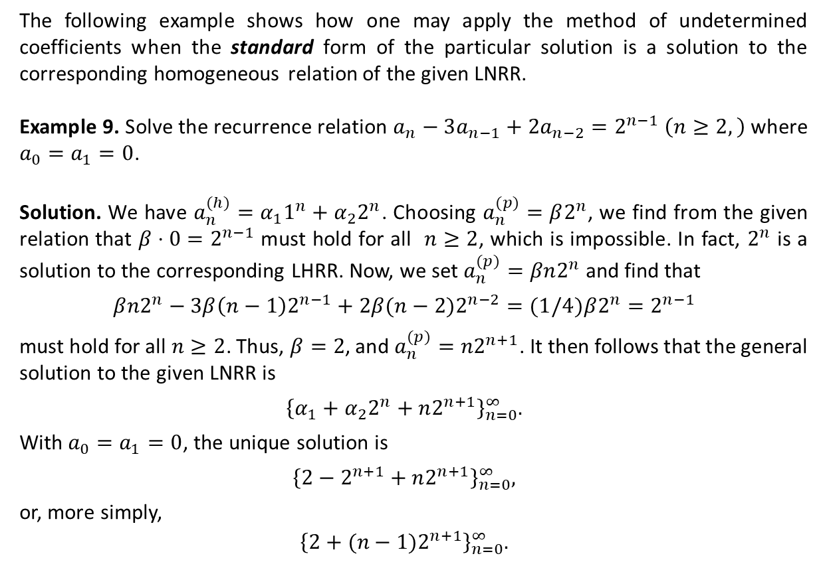
Solving LNRRs with Constant Coefficients (Ctd.)
The following example shows how one may apply the method of undetermined coefficients when the standard form of the particular solution is a solution to the corresponding homogeneous relation of the given LNRR.
Example 9. Solve the recurrence relation $a_{n}−3a_{n−1}+{2a}_{n−2}=2^{n−1}$ $\left(n≥2,\right)$ where $a_{0}=a_{1}=0$.
Solution. We have $a_{n}^{(h)}=α_{1}1^{n}+α_{2}2^{n}$. Choosing $a_{n}^{(p)}=β2^{n}$, we find from the given relation that $β⋅0=2^{n−1}$ must hold for all $n≥2$, which is impossible. In fact, $2^{n}$ is a solution to the corresponding LHRR. Now, we set $a_{n}^{(p)}=βn2^{n}$ and find that
$$β{n2}^{n}−3β{\left(n−1\right)2}^{n−1}+2β(n−2)2^{n−2}=(1/4)β2^{n}=2^{n−1}$$
must hold for all $n≥2$. Thus, $β=2$, and $a_{n}^{(p)}=n2^{n+1}$. It then follows that the general solution to the given LNRR is
$${\left\{α_{1}+α_{2}2^{n}+n2^{n+1}\right\}}_{n=0}^{∞}.$$
With $a_{0}=a_{1}=0$, the unique solution is
$${\left\{2−2^{n+1}+n2^{n+1}\right\}}_{n=0}^{∞},$$
or, more simply,
$${\left\{2+{(n−1)2}^{n+1}\right\}}_{n=0}^{∞}.$$

Slide 7
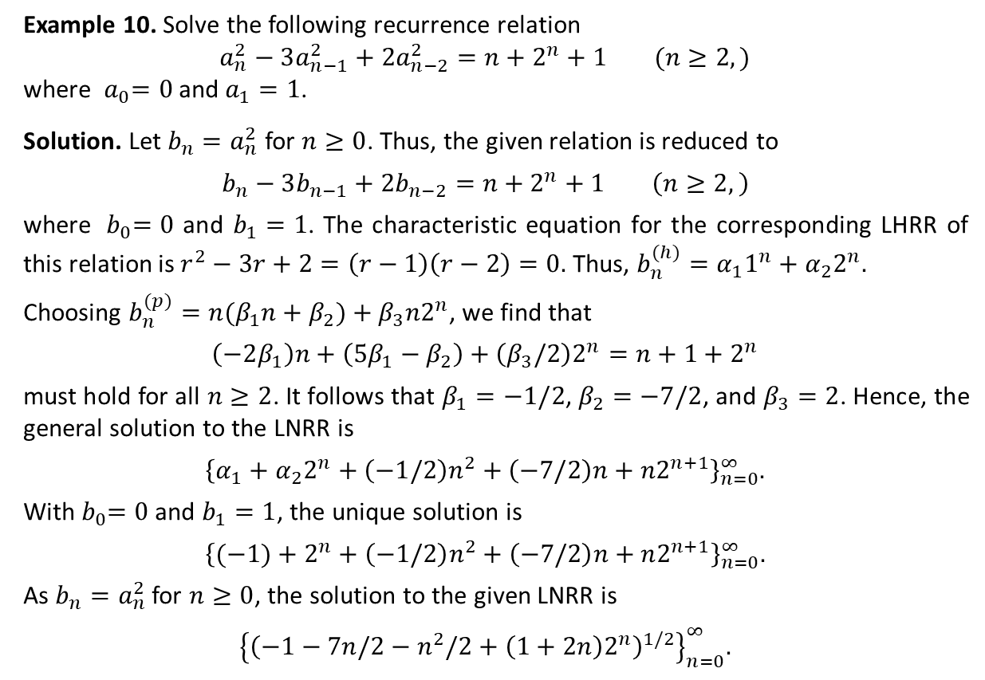
Solving LNRRs with Constant Coefficients (Ctd.)
Example 10. Solve the following recurrence relation
$$a_{n}^{2}−3a_{n−1}^{2}+{2a}_{n−2}^{2}=n+2^{n}+1 (n≥2, )$$
where ${ a}_{0}=0$ and $a_{1}=1$.
Solution. Let $b_{n}=a_{n}^{2}$ for $n≥0$. Thus, the given relation is reduced to
$$b_{n}−3b_{n−1}+2b_{n−2}=n+2^{n}+1 \left(n≥2,\right)$$
where ${ b}_{0}=0$ and $b_{1}=1$. The characteristic equation for the corresponding LHRR of this relation is $r^{2}−3r+2=\left(r−1\right)\left(r−2\right)=0.$ Thus, $b_{n}^{(h)}=α_{1}1^{n}+α_{2}2^{n}.$
Choosing $b_{n}^{(p)}=n(β_{1}n+β_{2})+β_{3}n2^{n}$, we find that
$$\left(−2β_{1}\right)n+\left(5β_{1}−β_{2}\right)+\left(β_{3}/2\right)2^{n}=n+1+2^{n}$$
must hold for all $n≥2$. It follows that $β_{1}=−1/2$, $β_{2}=−7/2$, and $β_{3}=2$. Hence, the general solution to the LNRR is
$${\left\{α_{1}+α_{2}2^{n}+\left(−1/2\right)n^{2}+\left(−7/2\right)n+n2^{n+1}\right\}}_{n=0}^{∞}.$$
With${ b}_{0}=0$ and $b_{1}=1$, the unique solution is
$${\left\{(−1)+2^{n}+\left(−1/2\right)n^{2}+\left(−7/2\right)n+n2^{n+1}\right\}}_{n=0}^{∞}.$$
As $b_{n}=a_{n}^{2}$ for $n≥0$, the solution to the given LNRR is
$${\left\{{\left(−1−7n/2−n^{2}/2+\left(1+2n\right)2^{n}\right)}^{1/2}\right\}}_{n=0}^{∞}.$$

Slide 8
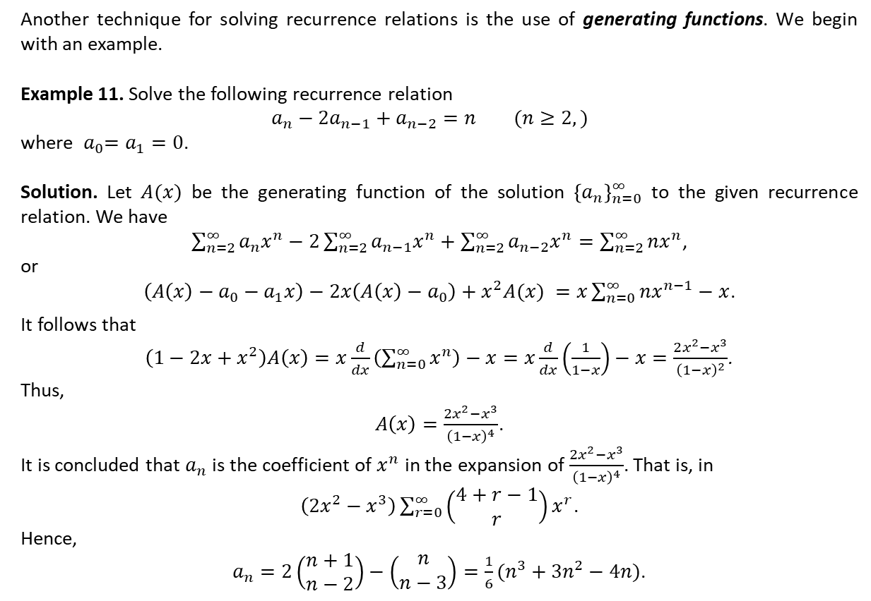
Solving Recurrence Relations Using Generating Functions
Another technique for solving recurrence relations is the use of generating functions. We begin with an example.
Example 11. Solve the following recurrence relation
$$a_{n}−2a_{n−1}+a_{n−2}=n (n≥2, )$$
where ${ a}_{0}=a_{1}=0$.
Solution. Let $A(x)$ be the generating function of the solution ${\left\{a_{n}\right\}}_{n=0}^{∞}$ to the given recurrence relation. We have
$\sum_{n=2}^{∞}{a_{n}x^{n}}−2\sum_{n=2}^{∞}{a_{n−1}x^{n}}+\sum_{n=2}^{∞}{a_{n−2}x^{n}}=\sum_{n=2}^{∞}{nx^{n}}$,
or
$\left(A\left(x\right)−a_{0}−a_{1}x\right)−2x\left(A\left(x\right)−a_{0}\right)+x^{2}A(x) =x\sum_{n=0}^{∞}{nx^{n−1}−x}$.
It follows that
$\left(1−2x+x^{2}\right)A\left(x\right)=x\frac{d}{dx}\left(\sum_{n=0}^{∞}{x^{n}}\right)−x=x\frac{d}{dx}\left(\frac{1}{1−x}\right)−x=\frac{2x^{2}−x^{3}}{{\left(1−x\right)}^{2}}$.
Thus,
$A\left(x\right)=\frac{2x^{2}−x^{3}}{{\left(1−x\right)}^{4}}$.
It is concluded that $a_{n}$ is the coefficient of $x^{n}$ in the expansion of $\frac{2x^{2}−x^{3}}{{\left(1−x\right)}^{4}}$. That is, in
$\left(2x^{2}−x^{3}\right)\sum_{r=0}^{∞}{\left(\begin{matrix}4+r−1 \\ r\end{matrix}\right)x^{r}}$.
Hence,
$a_{n}=2\left(\begin{matrix}n+1 \\ n−2\end{matrix}\right)−\left(\begin{matrix}n \\ n−3\end{matrix}\right)=\frac{1}{6}(n^{3}+3n^{2}−4n)$.

Slide 9
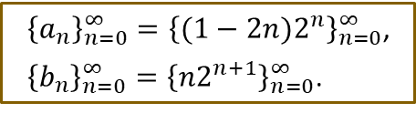
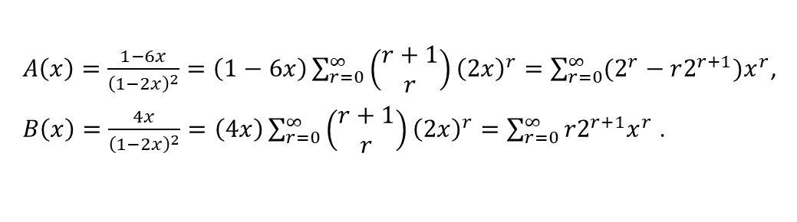

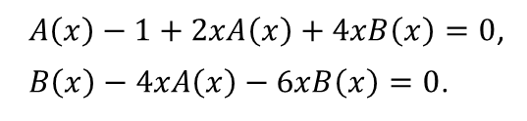
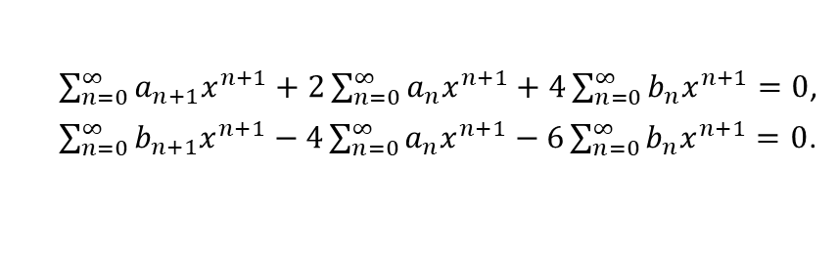
Solving Recurrence Relations Using Generating Functions (Ctd.)
Example 12. Solve the following system of recurrence relations
$a_{n+1}=−2a_{n}−4b_{n}$
$b_{n+1}=4a_{n}+6b_{n}$
where $n≥0$, $a_{0}=1$, and $b_{0}=0$.
Solution. Let $A(x)$ and $B\left(x\right)$ be respectively the generating functions of the sequences ${\left\{a_{n}\right\}}_{n=0}^{∞}$ and ${\left\{b_{n}\right\}}_{n=0}^{∞}$ that solve the given system of recurrence relations. We have
or
It follows that
Hence,
$\sum_{n=0}^{∞}{a_{n+1}x^{n+1}}+2\sum_{n=0}^{∞}{a_{n}x^{n+1}}+4\sum_{n=0}^{∞}{b_{n}x^{n+1}=0}$,
$\sum_{n=0}^{∞}{b_{n+1}x^{n+1}}−4\sum_{n=0}^{∞}{a_{n}x^{n+1}}−6\sum_{n=0}^{∞}{b_{n}x^{n+1}}=0$.
$A\left(x\right)−1+2xA\left(x\right)+4xB\left(x\right)=0$,
$B\left(x\right)−4xA\left(x\right)−6xB\left(x\right)=0$.
$A\left(x\right)=\frac{1−6x}{{\left(1−2x\right)}^{2}}=\left(1−6x\right)\sum_{r=0}^{∞}{\left(\begin{matrix}r+1 \\ r\end{matrix}\right){\left(2x\right)}^{r}}=\sum_{r=0}^{∞}{(2^{r}−r2^{r+1}})x^{r}$,
$B\left(x\right)=\frac{4x}{{\left(1−2x\right)}^{2}}=\left(4x\right)\sum_{r=0}^{∞}{\left(\begin{matrix}r+1 \\ r\end{matrix}\right){\left(2x\right)}^{r}}=\sum_{r=0}^{∞}{r2^{r+1}x^{r} }$.
${\left\{a_{n}\right\}}_{n=0}^{∞}={\left\{{(1−2n)2}^{n}\right\}}_{n=0}^{∞}$,
${\left\{b_{n}\right\}}_{n=0}^{∞}={\left\{n2^{n+1}\right\}}_{n=0}^{∞}$.

Slide 10
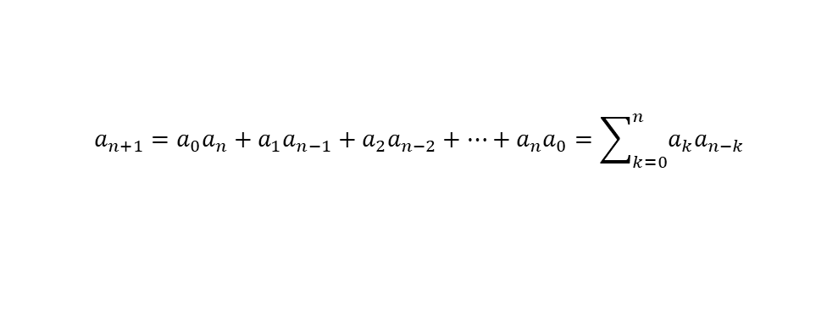
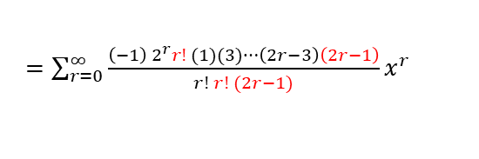
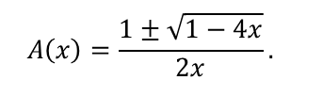
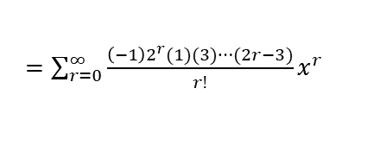


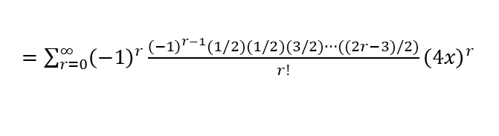
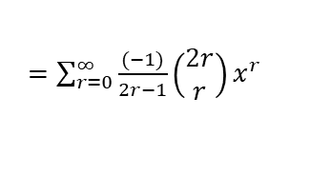
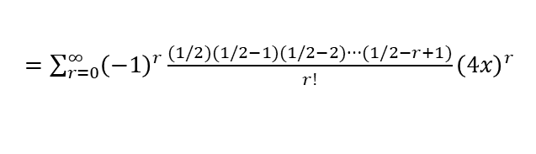
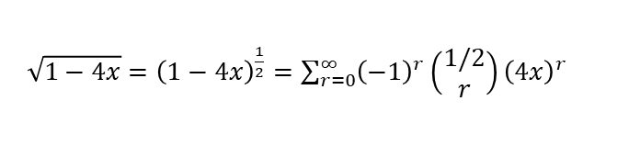
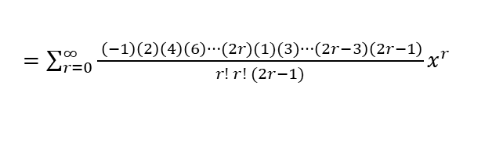
Solving Recurrence Relations Using Generating Functions (Ctd.)
Example 13. Solve the following nonlinear recurrence relation
where $n≥0$ and $a_{0}=1$.
Solution. Let $A(x)$ be the generating function of the sequence ${\left\{a_{n}\right\}}_{n=0}^{∞}$ that solves the given recurrence relations. We have
Thus,
It then follows that
We have
$$a_{n+1}=a_{0}a_{n}+a_{1}a_{n−1}+a_{2}a_{n−2}+…+a_{n}a_{0}=\sum_{k=0}^{n}{a_{k}a_{n−k}}$$
$$\sum_{n=0}^{∞}{a_{n+1}x^{n+1}=}\sum_{n=0}^{∞}{{(a}_{0}a_{n}+a_{1}a_{n−1}+a_{2}a_{n−2}+…+a_{n}a_{0})x^{n+1}}.$$
$$A\left(x\right)−1={x\left(A\left(x\right)\right)}^{2}.$$
$$A\left(x\right)=\frac{1±\sqrt{1−4x}}{2x}.$$
$\sqrt{1−4x}={\left(1−4x\right)}^{\frac{1}{2}}=\sum_{r=0}^{∞}{{\left(−1\right)}^{r}\left(\begin{matrix}1/2 \\ r\end{matrix}\right){\left(4x\right)}^{r}}$
$=\sum_{r=0}^{∞}{{\left(−1\right)}^{r}{\frac{(1/2)(1/2−1)(1/2−2)⋯(1/2−r+1)}{r!}\left(4x\right)}^{r}}$
$=\sum_{r=0}^{∞}{{\left(−1\right)}^{r}{\frac{{\left(−1\right)}^{r−1}(1/2)(1/2)(3/2)⋯((2r−3)/2)}{r!}\left(4x\right)}^{r}}$
$=\sum_{r=0}^{∞}{\frac{{\left(−1\right)2}^{r}(1)(3)⋯(2r−3)}{r!}x^{r}}$
$=\sum_{r=0}^{∞}{\frac{{\left(−1\right) 2}^{r}r! (1)(3)⋯\left(2r−3\right)\left(2r−1\right)}{r! r! (2r−1)}x^{r}}$
$=\sum_{r=0}^{∞}{\frac{ \left(−1\right)\left(2\right)\left(4\right)\left(6\right)⋯(2r)(1)(3)⋯\left(2r−3\right)\left(2r−1\right)}{r! r! (2r−1)}x^{r}}$
$=\sum_{r=0}^{∞}{\frac{(−1)}{2r−1}\left(\begin{matrix}2r \\ r\end{matrix}\right)x^{r}}$

Slide 11
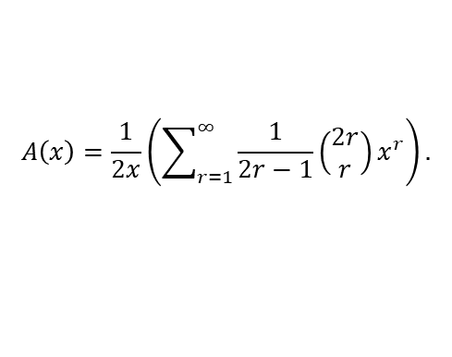
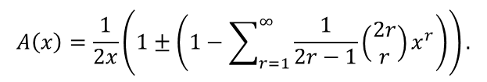

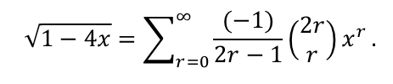




Solving Recurrence Relations Using Generating Functions (Ctd.)
We have
and
Thus,
The constant term in $A\left(x\right)$ is $±\frac{1}{2}\left(\begin{matrix}2 \\ 1\end{matrix}\right)=±1$. Thus, we should select the negative radical; otherwise we would have $a_{0}=−1$. Hence,
and the coefficient of $x^{n}$ in $A(x)$ is
or
$$A\left(x\right)=\frac{1±\sqrt{1−4x}}{2x}$$
$$\sqrt{1−4x}=\sum_{r=0}^{∞}{\frac{(−1)}{2r−1}\left(\begin{matrix}2r \\ r\end{matrix}\right)x^{r}}.$$
$$A\left(x\right)=\frac{1}{2x}\left(1±\left(1−\sum_{r=1}^{∞}{\frac{1}{2r−1}\left(\begin{matrix}2r \\ r\end{matrix}\right)x^{r}}\right)\right).$$
$$A\left(x\right)=\frac{1}{2x}\left(\sum_{r=1}^{∞}{\frac{1}{2r−1}\left(\begin{matrix}2r \\ r\end{matrix}\right)x^{r}}\right).$$
$$a_{n}=\frac{1}{2(2n+1)}\left(\begin{matrix}2n+2 \\ n+1\end{matrix}\right),$$
$$a_{n}=\frac{1}{n+1}\left(\begin{matrix}2n \\ n\end{matrix}\right).$$
(the $n$th Catalan number)

Slide 12
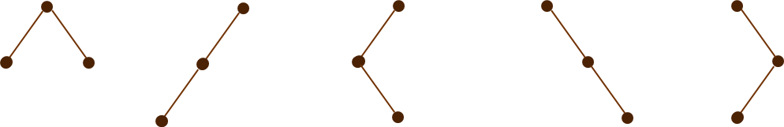
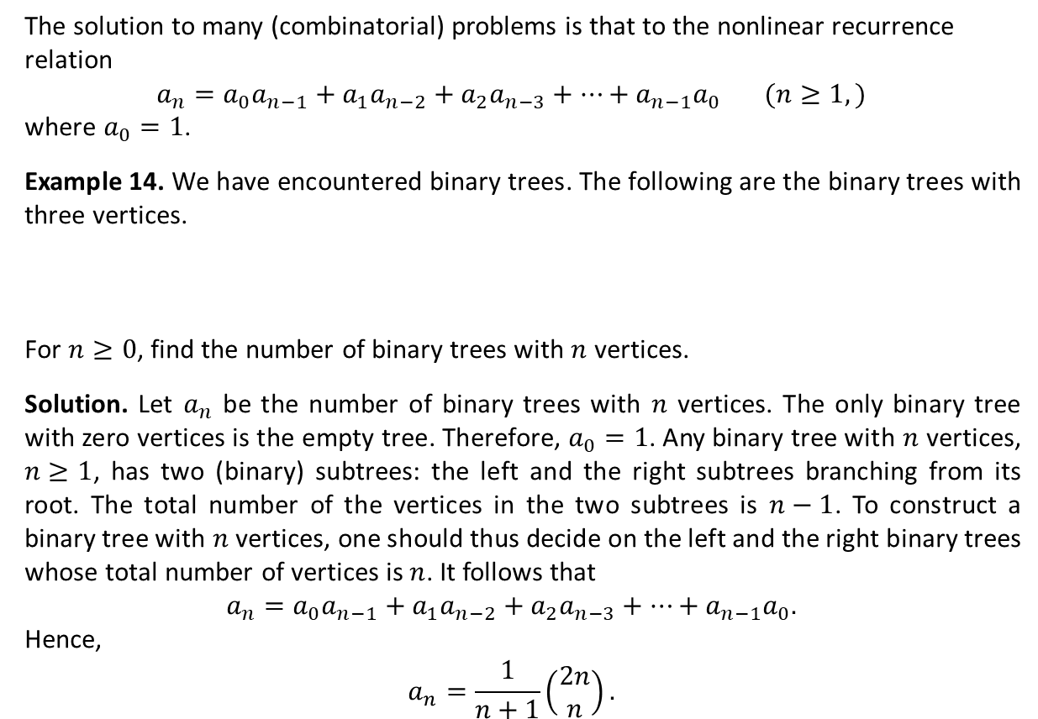
A Special Kind of Nonlinear Recurrence Relation
The solution to many (combinatorial) problems is that to the nonlinear recurrence relation
$$a_{n}=a_{0}a_{n−1}+a_{1}a_{n−2}+a_{2}a_{n−3}+…+a_{n−1}a_{0} (n≥1,)$$
where $a_{0}=1$.
Example 14. We have encountered binary trees. The following are the binary trees with three vertices.
For $n≥0$, find the number of binary trees with $n$ vertices.
Solution. Let $a_{n}$ be the number of binary trees with $n$ vertices. The only binary tree with zero vertices is the empty tree. Therefore, $a_{0}=1$. Any binary tree with $n$ vertices, $n≥1$, has two (binary) subtrees: the left and the right subtrees branching from its root. The total number of the vertices in the two subtrees is $n−1$. To construct a binary tree with $n$ vertices, one should thus decide on the left and the right binary trees whose total number of vertices is $n$. It follows that
$$a_{n}=a_{0}a_{n−1}+a_{1}a_{n−2}+a_{2}a_{n−3}+…+a_{n−1}a_{0}.$$
Hence,
$$a_{n}=\frac{1}{n+1}\left(\begin{matrix}2n \\ n\end{matrix}\right).$$

Slide 13










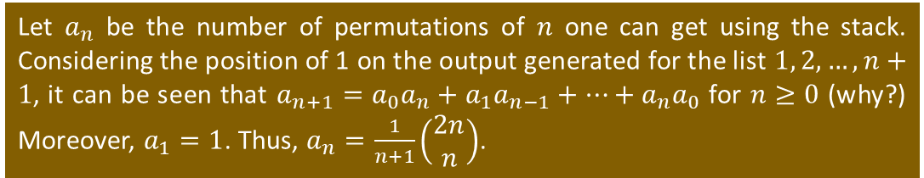
A Special Kind of Nonlinear Recurrence Relation (Ctd.)
However, we can obtain five of six permutations of 1, 2, 3. We cannot generate the permutation 3, 1, 2. For in order to have 3 in the first position of the permutation, we must build the stack by first pushing 1 onto the stack, then pushing 2 onto the top of the stack (on top of 1), and finally pushing 3 onto the stack (on top of 2). After 3 is popped from the top of the stack, we get 3 as the first number in our permutation. But with 2 now at the top of the stack, we cannot pop 1 until after 2 has been popped, so the permutation 3, 1, 2 cannot be generated.
Example 14. The data structure stack allows the storage of data items according to the following restrictions.
All insertions take place at one end of the structure. This is called the top of the stack, and the insertion process is referred to as the push procedure.
All deletions from the (nonempty) stack also take place from the top. We call the deletion process the pop procedure.
We may use this data structure to permute the (ordered) list $1, 2, 3, … , n$, for $n∈ℤ^{+}$. Each integer of the input $1, 2, 3, …, n$must be pushed onto the top of the stack in the order given. However, an entry from the top of the (nonempty) stack may be popped at any time. The process continues until no entry is left in the stack. Thus the ordered sequence of elements popped from the stack determines a permutation of $1, 2, 3, …, n$. How many permutations of $1, 2, 3, …, n$ can one get in this way?
Let $a_{n}$ be the number of permutations of $n$ one can get using the stack. Considering the position of 1 on the output generated for the list $1, 2, …, n+1$, it can be seen that $a_{n+1}=a_{0}a_{n}+a_{1}a_{n−1}+…+a_{n}a_{0}$ for $n≥0$ (why?) Moreover, $a_{1}=1$. Thus, $a_{n}=\frac{1}{n+1}\left(\begin{matrix}2n \\ n\end{matrix}\right)$.
Output
$$1$$
$$2$$
$$1, 2, 3, …, n$$
Input
push $1$
push $2$
pop
pop
$$: 2, 1$$
push $1$
pop
push $2$
pop
$$: 1, 2$$

Slide 14
Textbook: Ralph P. Grimaldi, Discrete and Combinatorial Mathematics
Please consult with Chapter 10 of your textbook.

